Slide 1

5/4/2022
Escape From The Gnome Depot: A Unity Game Engine Horror Experience
CSCI 4890: Computer Projects
Author: Samuel Bartrug
Advisor: Dr. John Sullins

Slide 2
5/4/2022
The Problem
CSCI 4890: Computer Projects
Needed to produce an interesting and enjoyable game that was feasible to pull off as a one-man development team
The game needed to expand upon my current knowledge as well as let me expand into further territories I hadn’t ventured into previously
This concept was to use AI path planning and a state machine in order to create a functioning AI that acted somewhat realistically
A 3D game provided a great amount of challenge
Video games involve both graphic elements as well as scripting to create logic by which those elements will interact with each other and the world around them
Having to create models that can exist and interact in a 3D environment is very difficult

Slide 3
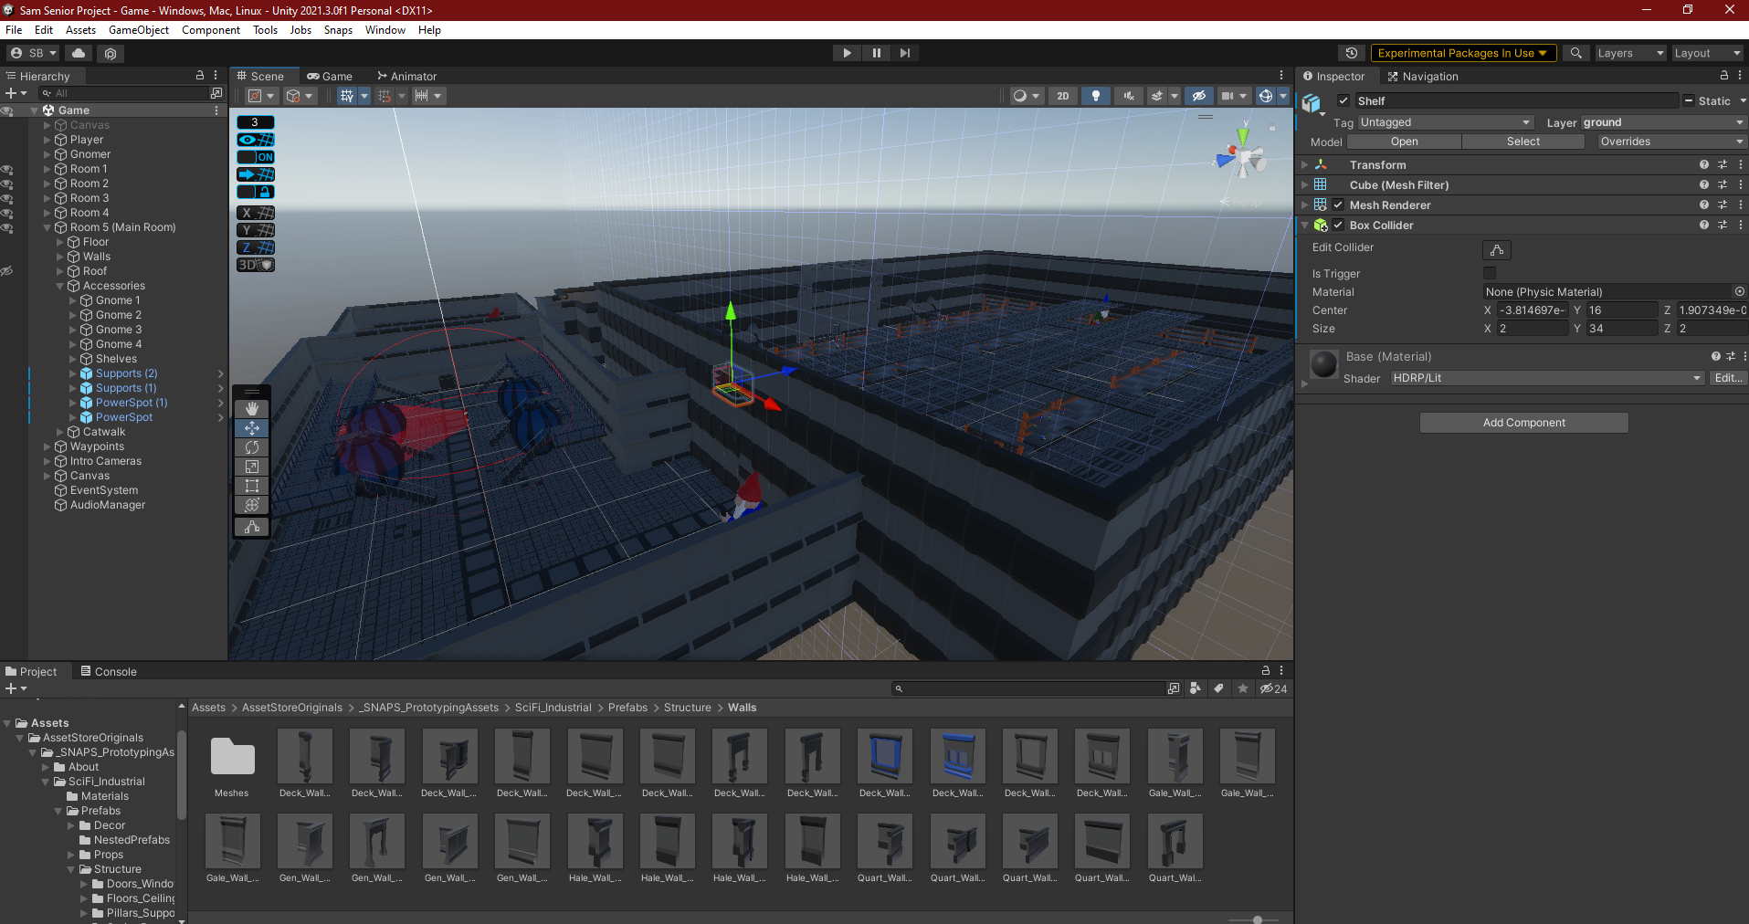
5/4/2022
Software Utilized
CSCI 4890: Computer Projects
I chose Unity as there is a great reservoir of knowledge with a good amount of documentation and easy implementation with modeling software's such as Blender
Unity is extremely versatile as it allows development for numerous platforms and formats

Slide 4
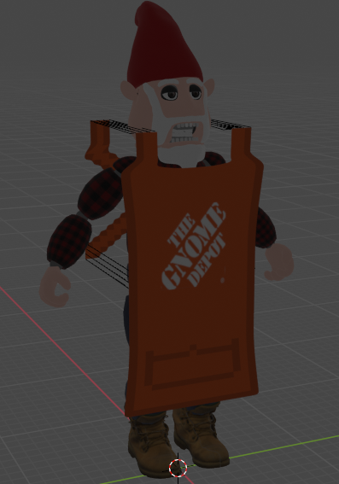
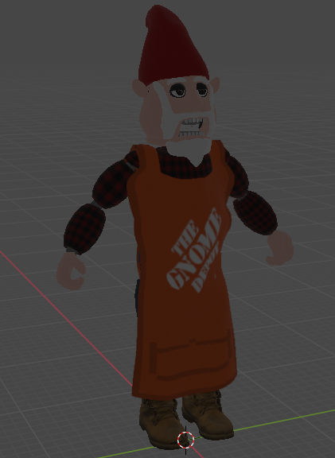
5/4/2022
Software Utilized
CSCI 4890: Computer Projects
I chose to use Blender as through the semester I had the chance to learn more about the software and its many capabilities
Additionally, I combined new aspects such as the integration of sewing and cloth physics as well as sculpting with traditional modeling with extrusion and shade smoothing

Slide 5
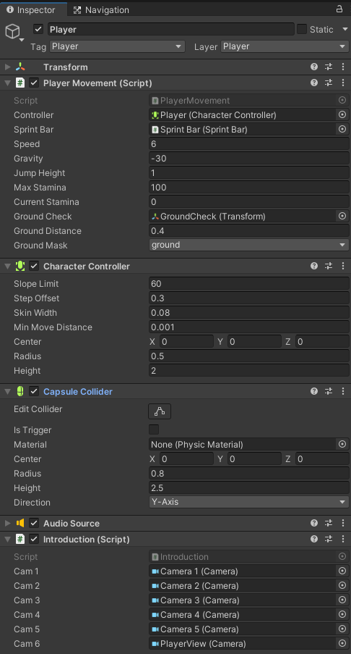

5/4/2022
Code Analysis: Player Movement
CSCI 4890: Computer Projects
Game was first person
Utilized a simple model of a cylinder since the user will never see themselves
Player Movement script included my own physics over using rigid body
Utilized an empty ground check to verify when the player is standing on a walkable surface so that they can’t jump on thin air

Slide 6
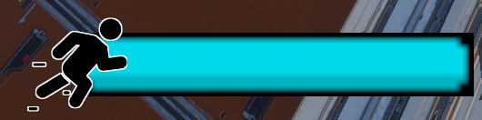
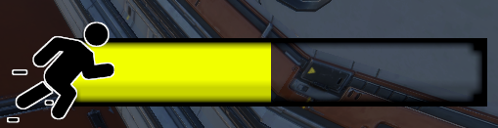
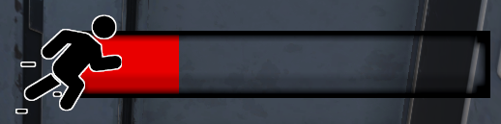
5/4/2022
Code Analysis: UI
CSCI 4890: Computer Projects
Implemented a custom-made sprint bar UI asset that drains as you hold shift to sprint and utilizes a gradient to slowly shift from blue to yellow to red as it runs out.

Slide 7
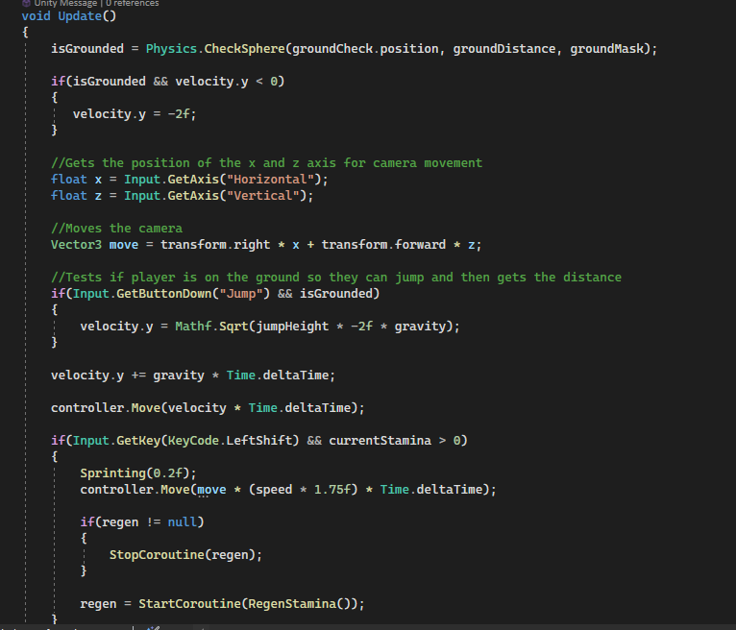
5/4/2022
Code Analysis: Player Movement
CSCI 4890: Computer Projects
Update function of player movement checks if the players is touching the ground with the ground check object
Utilizes a coroutine in order to time out how long it takes to regen the stamina for sprinting and to reset that recharge time if you try to use it before it gets a chance to recharge

Slide 8
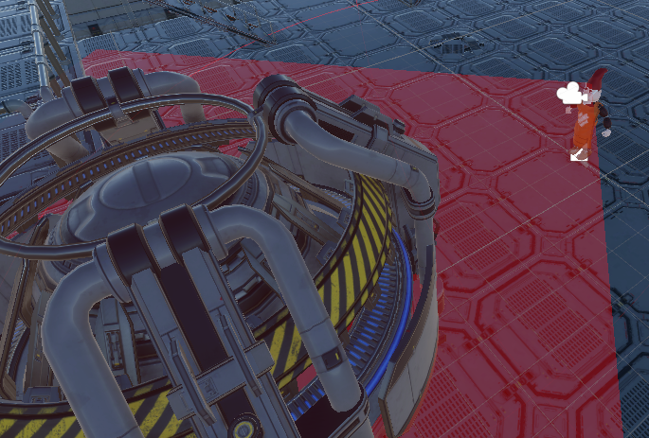
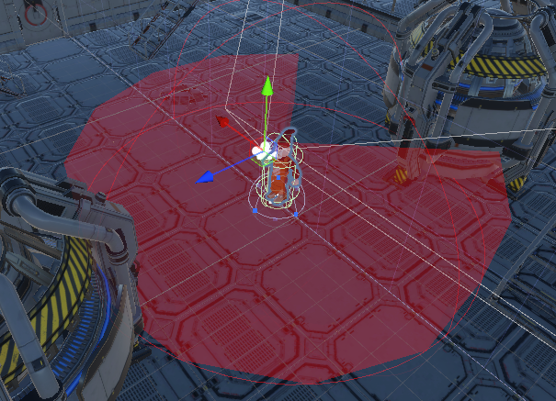
Code Analysis: Raycasting & Meshes Oh My!
5/4/2022
CSCI 4890: Computer Projects
Utilizing the combination of Raycasting and the creation of a fully adjustable mesh created with my scripts, I was able to properly raycast in a desired angle and range in front of my villain Gnomer
By additionally introducing a layer mask array for which layers to occlude from the scan, I was also able to make it so that the detection didn’t go through objects on certain layers so Gnomer couldn’t sniff you out like a hound

Slide 9
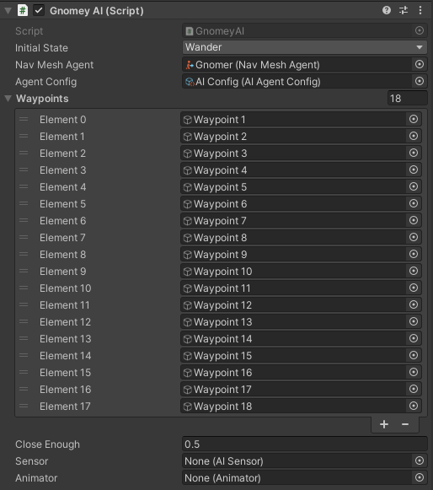
5/4/2022
Code Analysis: Gnomer
CSCI 4890: Computer Projects
Gnomer was by far the most difficult of the coding to accomplish as he has sound, animation, navmesh, and a finite state machine all as parts of his scripts
For his wander state which is the initial state he spawns in, he walks randomly between 18 different random way points on the map so that he has maximum unpredictability

Slide 10
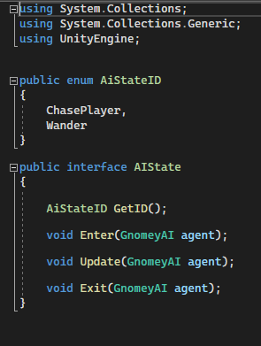
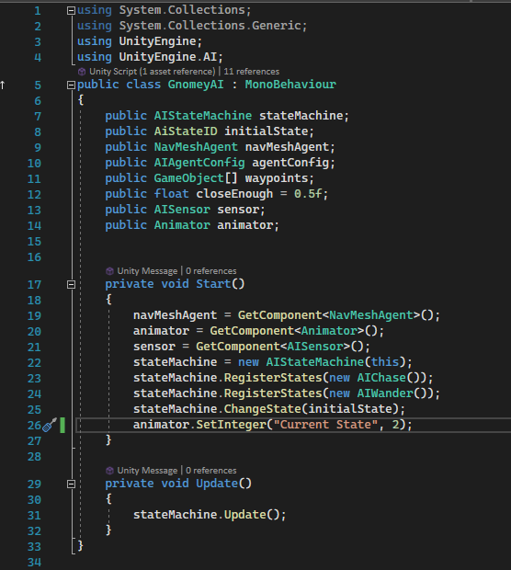
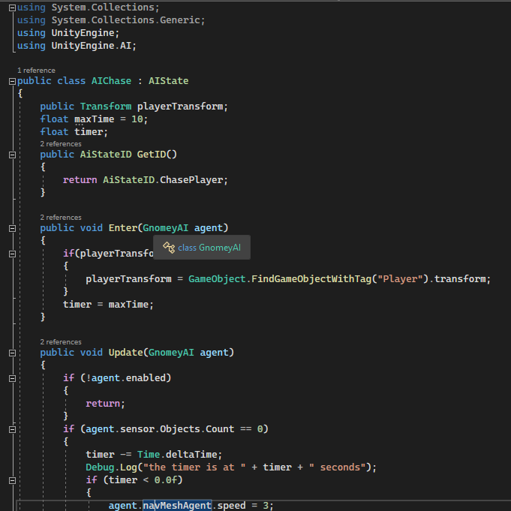
5/4/2022
Code Analysis: Gnomer
CSCI 4890: Computer Projects

Slide 11

5/4/2022
Audio Clip Examples
CSCI 4890: Computer Projects

Slide 12
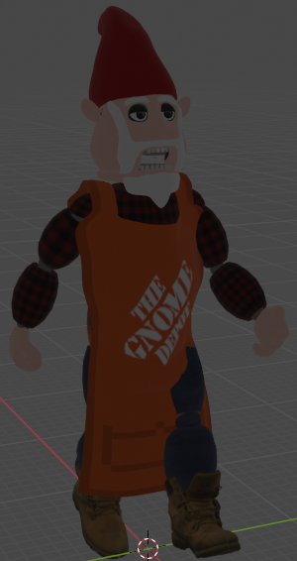
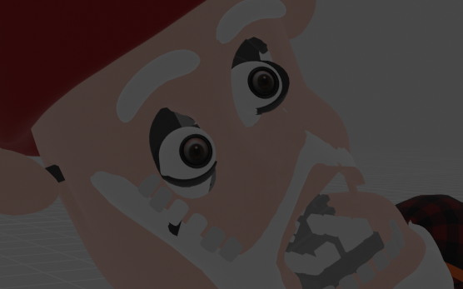
5/4/2022
Challenges
CSCI 4890: Computer Projects
Creating the graphical elements of my game proved to be much more difficult than I originally planned
In my head I was able to imagine fantastical graphics and beautiful animations like I’ve seen in other indie games
Sadly, the very concept of parenting armatures with automatic weights and it weighting correctly is but a distant fantasy
Weight painting became my only hope for decent movements and even then, I had to be careful
Gnomer’s Top Teeth

Slide 13
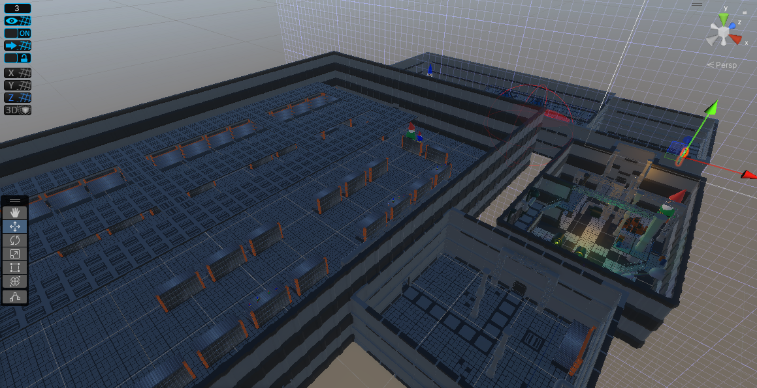
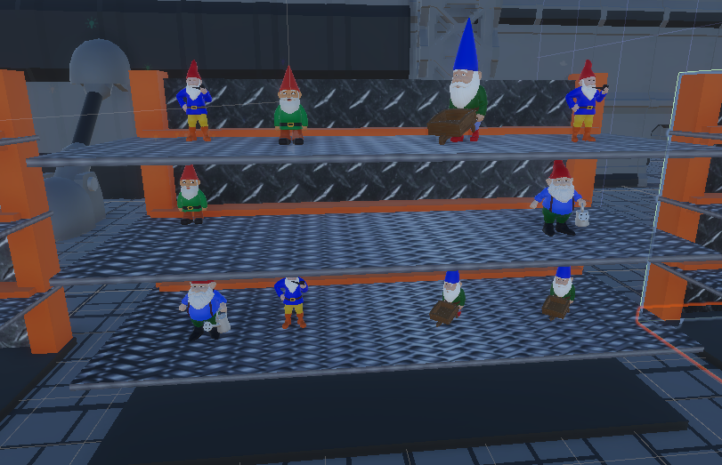
5/4/2022
Challenges
CSCI 4890: Computer Projects
Unity is an extremely versatile game engine, but the only reason it is that way is because you need to write a script for just about everything
Creating a flickering light required a C# script, opening a door required a script, and even just getting the player model to move around the game required a script
Scale was one of my largest challenges

Slide 14
5/4/2022
Into The Future
CSCI 4890: Computer Projects
Work on redesigning the meshes and armature of Gnomer to see if I can’t master animations and armatures
Incorporate more interactive elements such as giving the player an end goal beyond simply surviving against Gnomer.
Creating pickups that spawn in random locations to unlock the exit, creating a way to fight back against Gnomer such as using a flashlight to stun him, etc.
Create a more challenging AI because as of now, the most Gnomer can do at you is follow you. Perhaps he has some additional murderous friends that could utilize pack tactics to cut the player off

Slide 15
5/4/2022
Acknowledgements
CSCI 4890: Computer Projects
I’d like to thank all my professors who have gotten me to this point such as Dr. Kramer, Mr. Jones, and especially Dr. Sullins for his encouragement and kindness throughout the course of this project's development
I’m also extremely grateful to the kind community of likeminded developers that choose to share their knowledge on a myriad of subjects surrounding game development as without them, I would have not come as far as I did

Slide 16
5/4/2022
Thank You!
CSCI 4890: Computer Projects
Unity Project & Blender Models will be uploaded to my GitHub
Any Questions?

